Slide 1
Portfolio Optimization Using Hybrid Quantum Algorithms

Slide 2
Disclaimer
Investment advice is neither given nor intended
The research views expressed herein are those of the author and do not necessarily represent the views of 1QBit or its affiliates.
All examples in this presentation are hypothetical interpretations of situations and are used for explanation purposes only.
This report and the information herein should not be considered investment advice or the results of actual market experience.

Slide 3
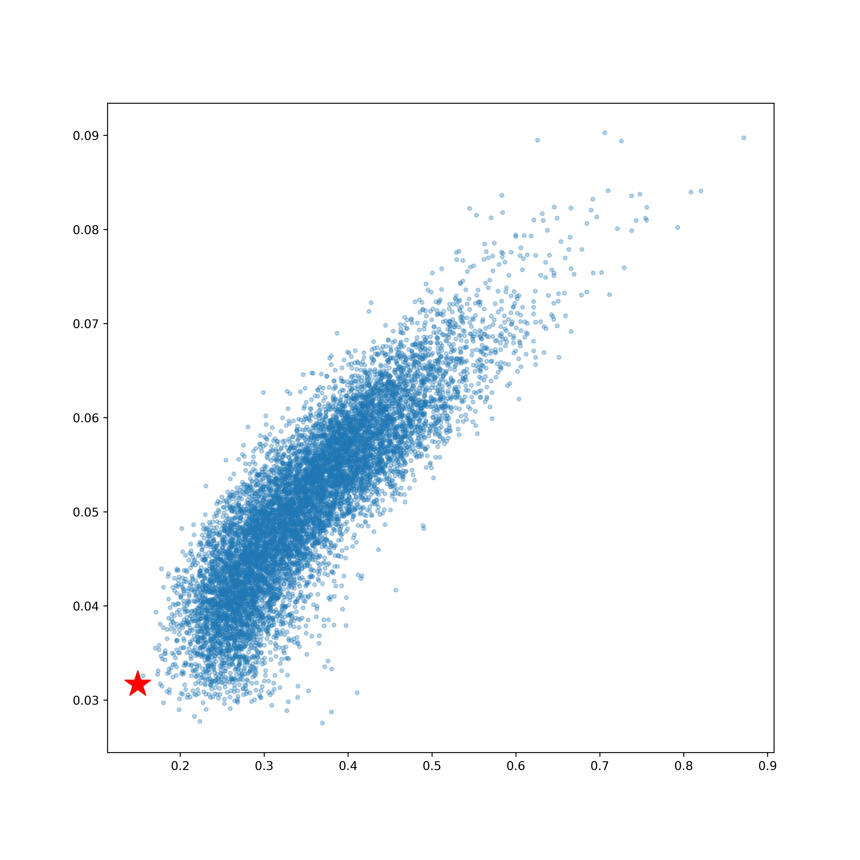
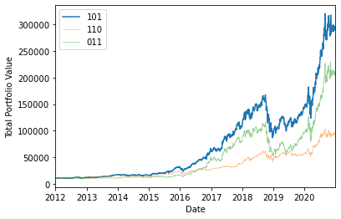
A Refresher – Portfolio Optimization
Portfolio Optimization is relevant to both retail investors and investment groups.
Pick the “best” portfolio is an optimization problem.
There are different ways to set up and perform portfolio optimization – Efficient Frontier, etc.
Optimal portfolio may look different depending on investor – high return, low volatility, etc.
Efficient Frontier portfolio optimization.
Example portfolios over time.
Notes:
Start them off with something they know (a familiar world), then go to the unknown.

Slide 4
Introduction – Quantum Computing
Current quantum computing hardware is limited by the number of qubits, connectivity, and a number of other factors.
We can use small-scale hardware, using a combination of classical and quantum computing techniques.
Two relevant hybrid algorithms for portfolio optimization :
Variational Quantum Eigensolver (VQE)
Quantum Approximate Optimization Algorithm (QAOA)
Notes:
Cut down wording. 1. Current Hardware limited 2. We can make use of small hardware using a mix of quantum and classical techniques, 3. Namely VQE QAOA

Slide 5
Introduction – Quantum Portfolio Optimization
We will solve a portfolio optimization problem
Classically,
With the Variational Quantum Eigensolver, and
With the Quantum Approximate Optimization Algorithm,
using qiskit (IBM’s quantum SDK ).
The Context of Quantum Realism:
Prepare for the “Quantum Surprise” by understanding where quantum computing is right now, and where benefits are to be had as the hardware evolves in the future.

Slide 6
Portfolio Optimization Problem

Slide 7
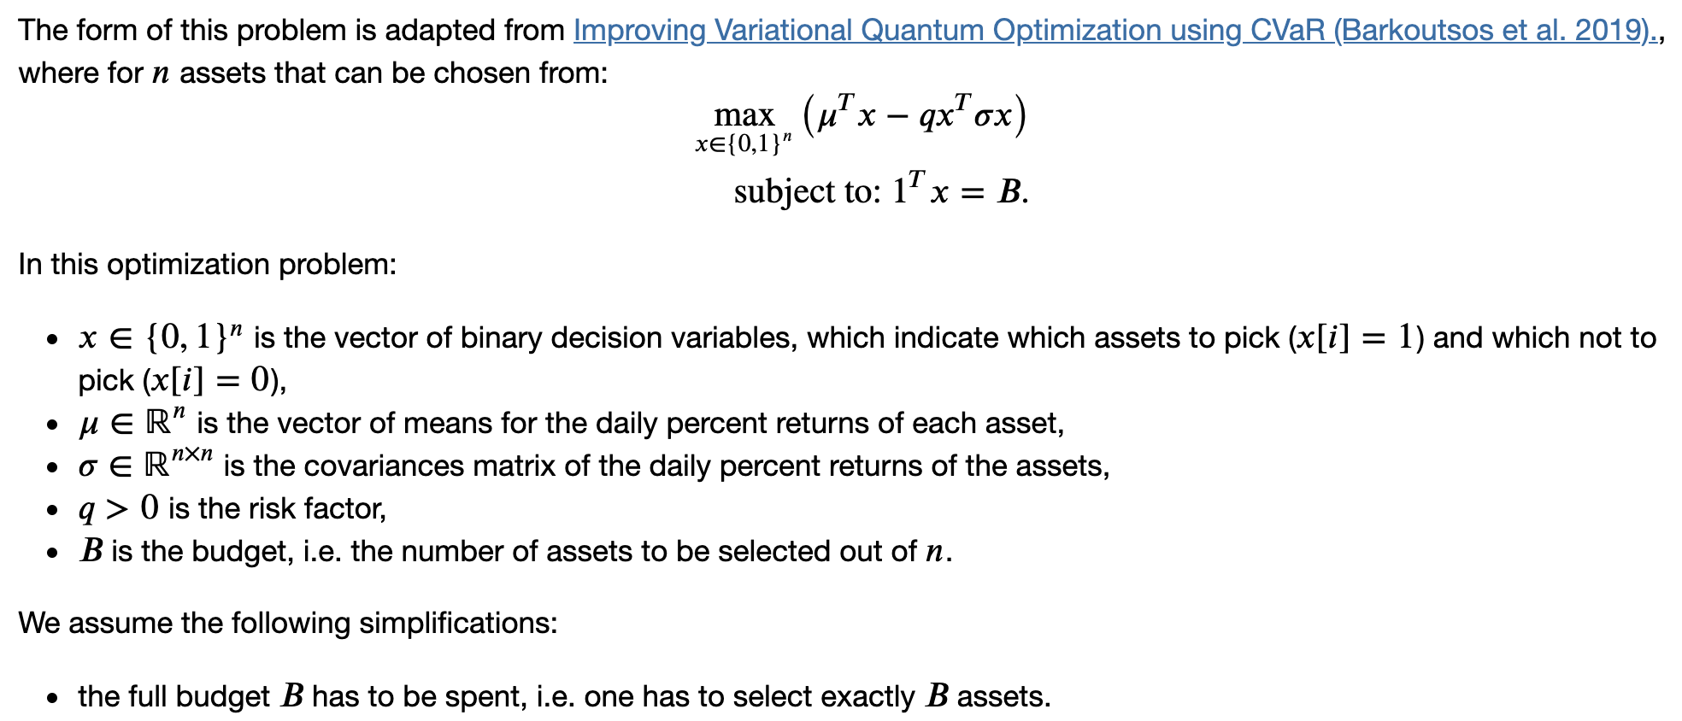
Portfolio Optimization Problem

Slide 8
Considerations and Limitations
There is a desire to forecast results, however this method doesn’t guarantee a prediction of the best portfolio.
The method calculates the “best” portfolio by looking back over a period of time.
The covariance calculation is for a fixed period.
A need to address these limitations in the real world.
Can make an estimate on how long the portfolio calculated will be relevant.
Can recalculate and rebalance as needed.

Slide 9
Variational Quantum Eigensolver

Slide 10
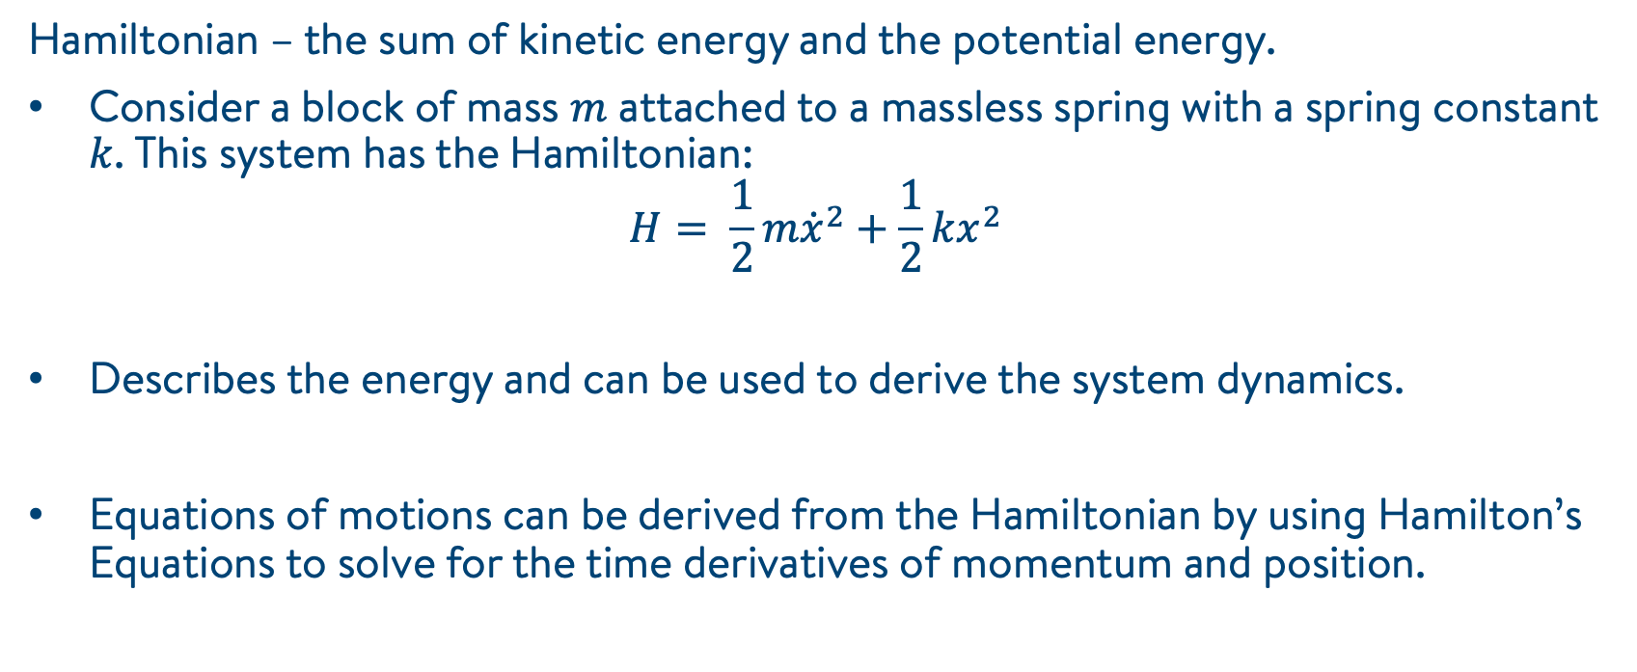
Hamiltonian: From Classical …
Hamiltonian – the sum of kinetic energy and the potential energy.
Consider a block of mass $m$ attached to a massless spring with a spring constant $k$. This system has the Hamiltonian:
$$H= \frac{1}{2}m{\dot{x}}^{2}+\frac{1}{2}kx^{2}$$
Describes the energy and can be used to derive the system dynamics.
Equations of motions can be derived from the Hamiltonian by using Hamilton’s Equations to solve for the time derivatives of momentum and position.

Slide 11
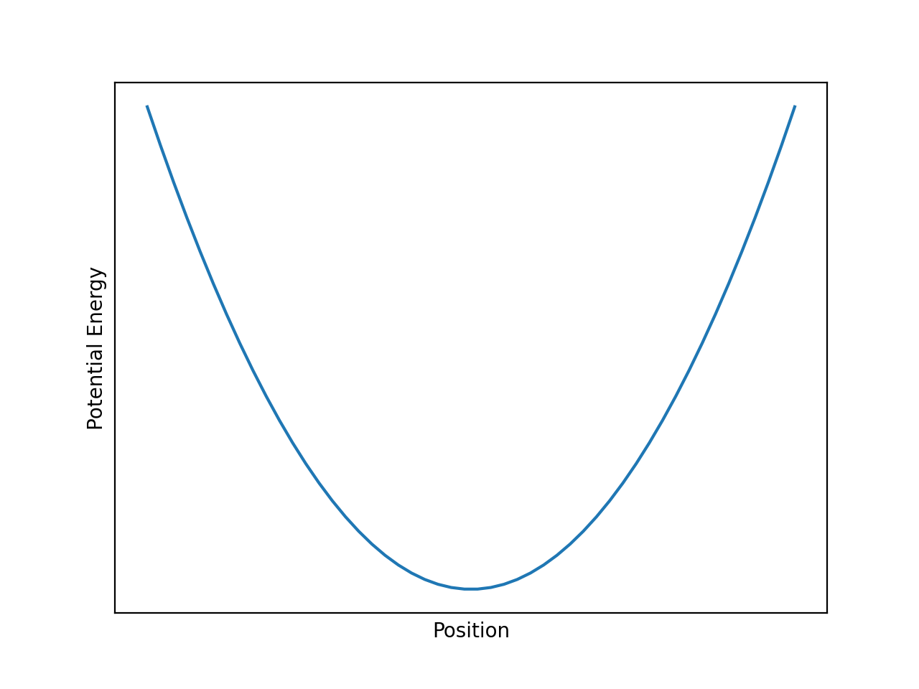
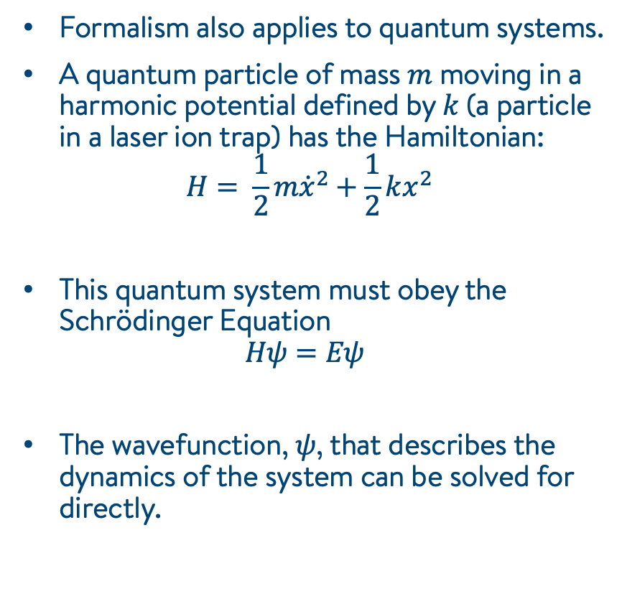
Hamiltonian: From Classical to Quantum
Formalism also applies to quantum systems.
A quantum particle of mass $m$ moving in a harmonic potential defined by $k$ (a particle in a laser ion trap) has the Hamiltonian:
$$H= \frac{1}{2}m{\dot{x}}^{2}+\frac{1}{2}kx^{2}$$
This quantum system must obey the Schrödinger Equation
$$Hψ=Eψ$$
The wavefunction, $ψ$, that describes the dynamics of the system can be solved for directly.
The potential that the quantum particle occupies.

Slide 12
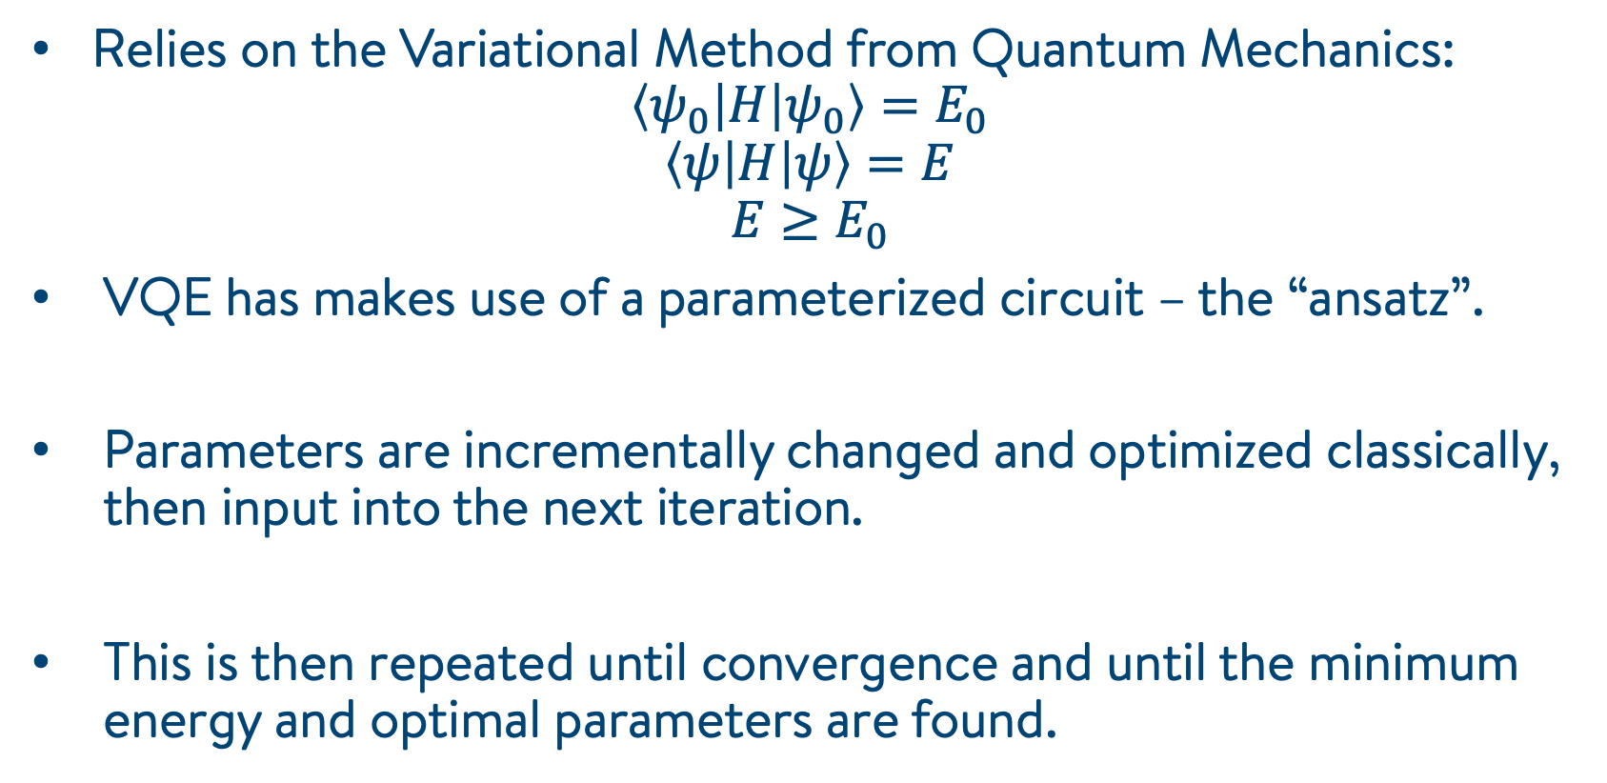
Variational Quantum Eigensolver
Relies on the Variational Method from Quantum Mechanics:
$$\left\langle ψ_{0} | H | ψ_{0}\right\rangle =E_{0}$$
$$\left\langle ψ | H | ψ\right\rangle =E$$
$$E≥E_{0}$$
VQE has makes use of a parameterized circuit – the “ansatz”.
Parameters are incrementally changed and optimized classically, then input into the next iteration.
This is then repeated until convergence and until the minimum energy and optimal parameters are found.

Slide 13
Variational Quantum Eigensolver
Prepare Parametrized State (Ansatz)
Compute Energy Using a Quantum Circuit
Use a Classical Optimizer to Find Better Parameters

Slide 14
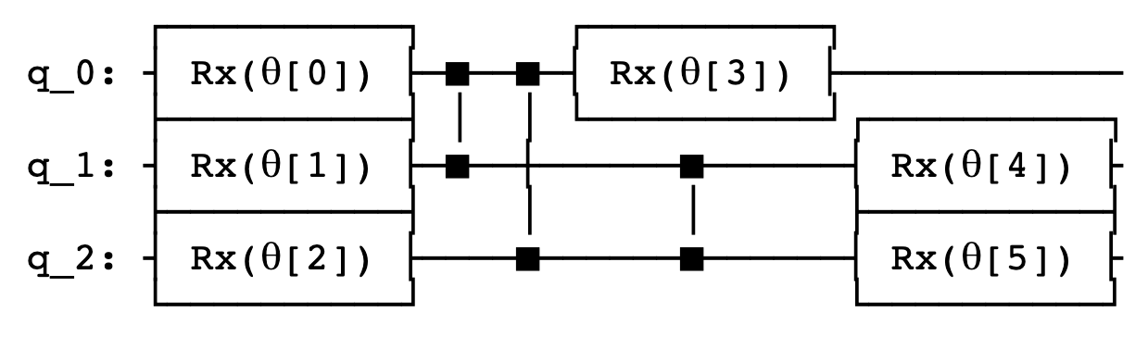
Variational Quantum Eigensolver
The choice of Ansatz dictates the accuracy of your results, and the efficiency of your algorithm.
The choice is limited by hardware capabilities.

Slide 15
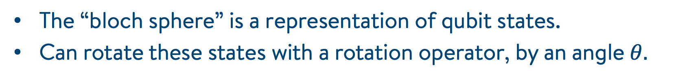
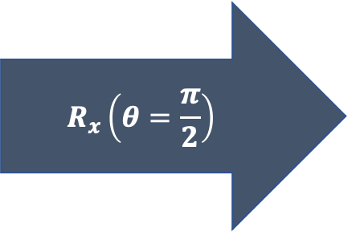
Rotating Qubits
The “bloch sphere” is a representation of qubit states.
Can rotate these states with a rotation operator, by an angle $θ.$
$$R_{x}\left(θ=\frac{π}{2}\right)$$

Slide 16
Quantum Approximate Optimization Algorithm

Slide 17
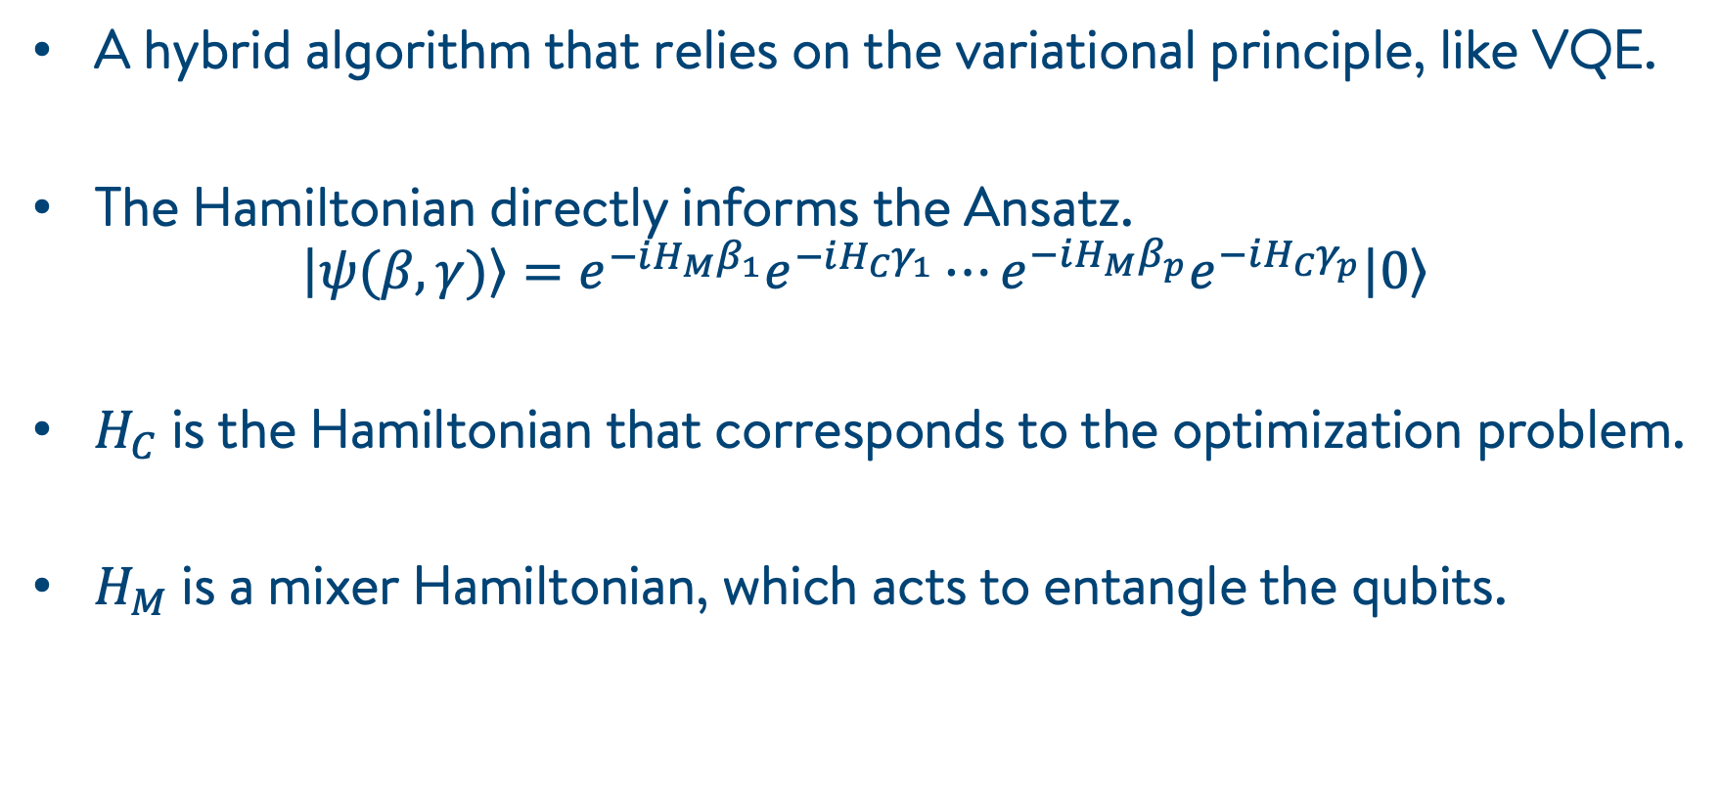
Quantum Approximate Optimization Algorithm
A hybrid algorithm that relies on the variational principle, like VQE.
The Hamiltonian directly informs the Ansatz.
$$\left.\left|ψ(β,γ)\right.\right\rangle =e^{−iH_{M}β_{1}}e^{−iH_{C}γ_{1}}⋯e^{−iH_{M}β_{p}}e^{−iH_{C}γ_{p}}\left.\left|0\right.\right\rangle$$
$H_{C}$ is the Hamiltonian that corresponds to the optimization problem.
$H_{M}$ is a mixer Hamiltonian, which acts to entangle the qubits.

Slide 18
Interpreting Results

Slide 19
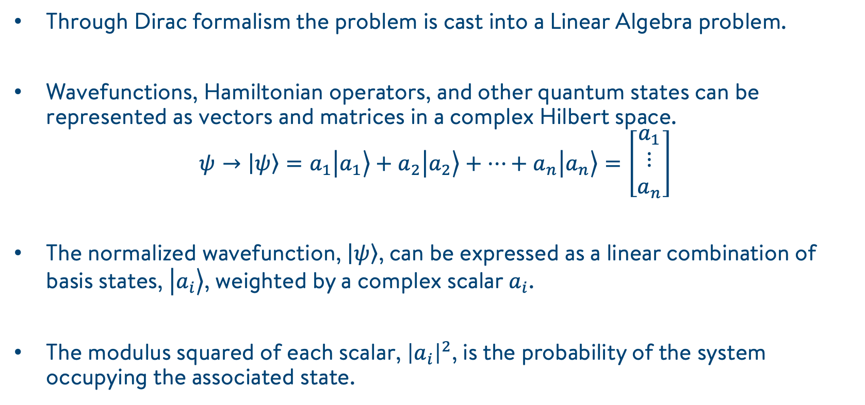
Dirac Formalism (Bra-Ket Notation)
Through Dirac formalism the problem is cast into a Linear Algebra problem.
Wavefunctions, Hamiltonian operators, and other quantum states can be represented as vectors and matrices in a complex Hilbert space.
$$ψ→\left.\left|ψ\right.\right\rangle =a_{1}\left.\left|a_{1}\right.\right\rangle +a_{2}\left.\left|a_{2}\right.\right\rangle +⋯+a_{n}\left.\left|a_{n}\right.\right\rangle =\left[\begin{matrix}a_{1} \\ ⋮ \\ a_{n}\end{matrix}\right]$$
The normalized wavefunction, $\left.\left|ψ\right.\right\rangle$, can be expressed as a linear combination of basis states, $\left.\left|a_{i}\right.\right\rangle$, weighted by a complex scalar $a_{i}$.
The modulus squared of each scalar, ${\left|a_{i}\right|}^{2}$, is the probability of the system occupying the associated state.
Notes:
Focus on probabilities

Slide 20
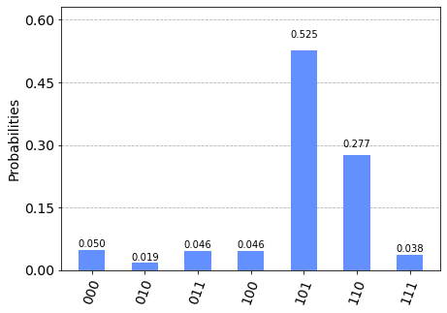
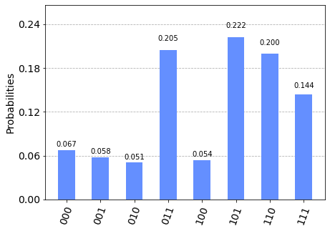
Results
VQE
QAOA

Slide 21
Summary of Results
We refreshed ourselves on Portfolio Optimization and cast the problem as a qubo.
We introduced concepts from quantum mechanics and how they apply to the hybrid quantum computing algorithms – VQE, QAOA.
We learned how to interpret the probabilistic output from the two algorithms.
We saw how they map back to the original and familiar problem.
Now we can apply this to a more realistic scenario.

Slide 22
Applied to Real Data

Slide 23
Motivating Research Questions
How many and which equity benchmarks does an endowment portfolio really need?
How does this change for different periods?

Slide 24
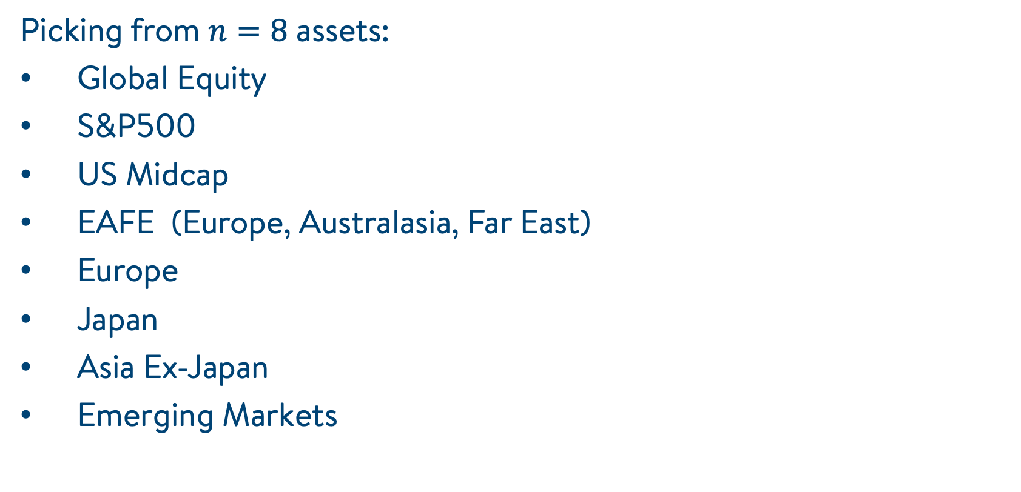
Data
Picking from $n=8$ assets:
Global Equity
S&P500
US Midcap
EAFE (Europe, Australasia, Far East)
Europe
Japan
Asia Ex-Japan
Emerging Markets

Slide 25
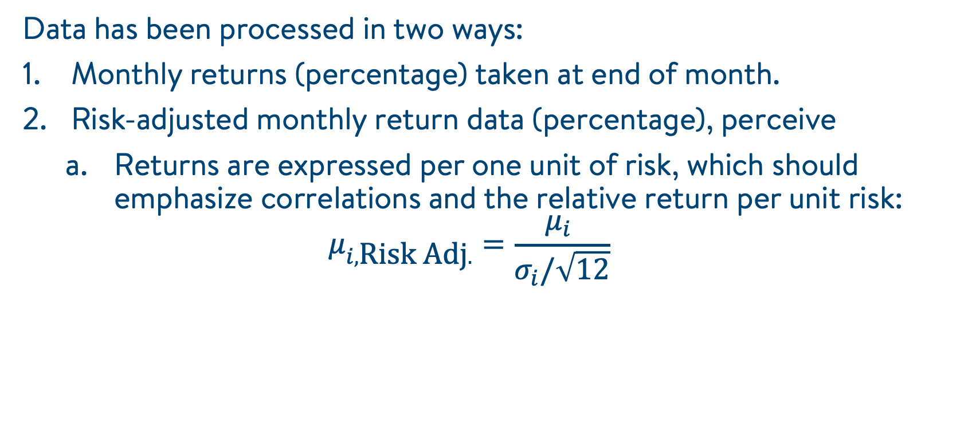
Data
Data has been processed in two ways:
Monthly returns (percentage) taken at end of month.
Risk-adjusted monthly return data (percentage), perceive
Returns are expressed per one unit of risk, which should emphasize correlations and the relative return per unit risk:
$$μ_{i,\text{Risk} \text{Adj}.}=\frac{μ_{i} }{σ_{i}/\sqrt{12}}$$

Slide 26
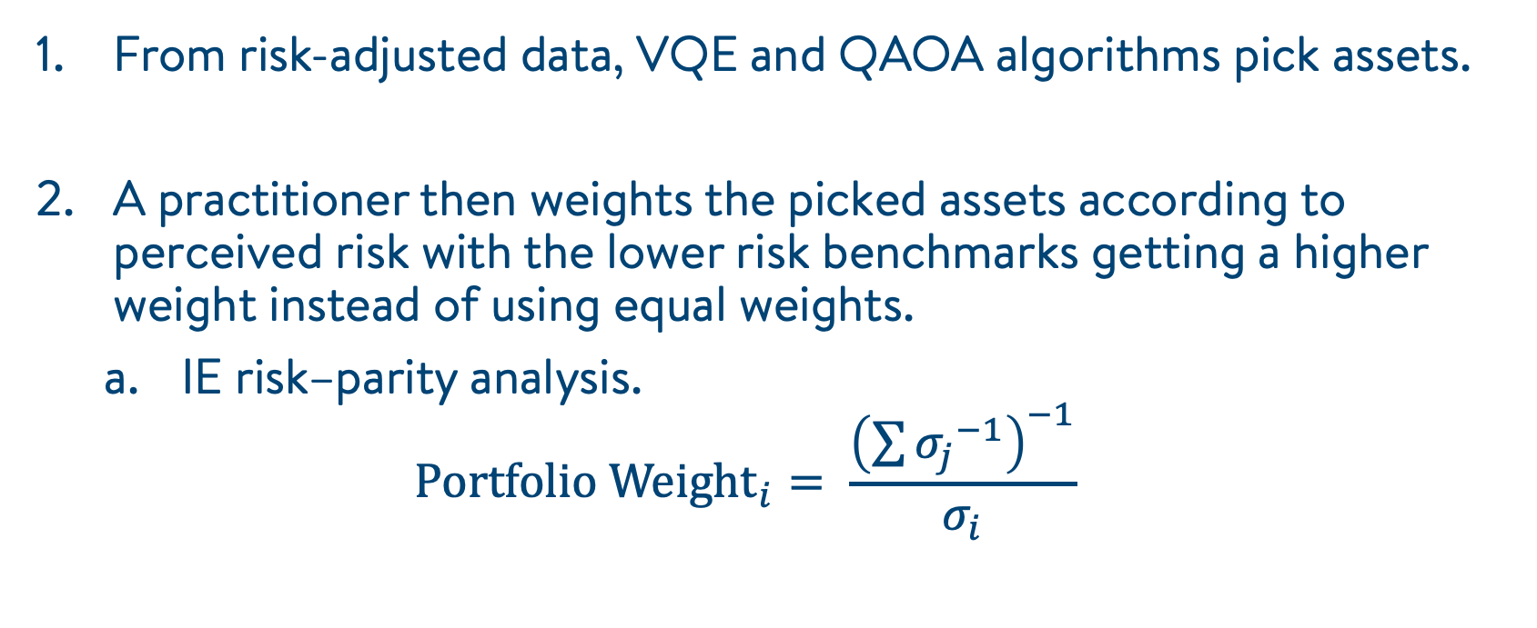
How VQE/QAOA Can Be Applied
From risk-adjusted data, VQE and QAOA algorithms pick assets.
A practitioner then weights the picked assets according to perceived risk with the lower risk benchmarks getting a higher weight instead of using equal weights.
IE risk–parity analysis.
$${\text{Portfolio} \text{Weight}}_{i}= \frac{{\left(\sum{{σ_{j}}^{−1}}\right)}^{−1}}{σ_{i}}$$

Slide 27
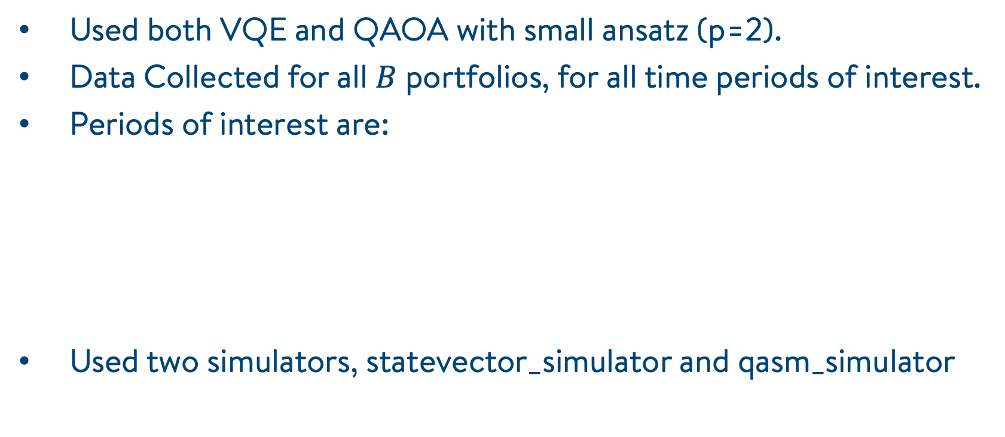
Methods
Used both VQE and QAOA with small ansatz (p=2).
Data Collected for all $B$ portfolios, for all time periods of interest.
Periods of interest are:
Used two simulators, statevector_simulator and qasm_simulator

Slide 28
Results
Left – non-scaled, Right – risk-scaled
Japan looks to have much lower covariance over all periods

Slide 29
Results
From period-to-period, there is a shift in the covariances.
Below are non-scaled.

Slide 30
Results
From period-to-period, there is a shift in the covariances.
Below are risk-scaled.

Slide 31
Results
QAOA tends to be more accurate than VQE, relative to classical.
Statevector_simulator is more consistent than qasm_simulator. The latter samples results in shots (similar to a real device)
Generally, the risk-scaled distributions (bottom) from the results lead to better distributions than non-scaled (top).
Non-scaled
Risk-scaled

Slide 32


Results
Non-scaled example with $B=5$, $q=0.0, 0.5, 20.$
Sanity check to show that our qubo is valid.

Slide 33
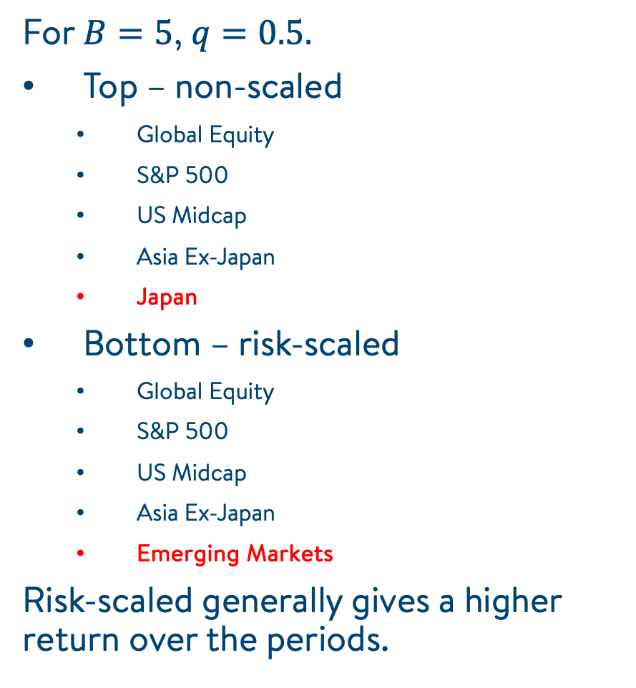
Results
Non-scaled
For $B=5$, $q=0.5.$
Top – non-scaled
Global Equity
S&P 500
US Midcap
Asia Ex-Japan
Japan
Bottom – risk-scaled
Global Equity
S&P 500
US Midcap
Asia Ex-Japan
Emerging Markets
Risk-scaled generally gives a higher return over the periods.
Risk-scaled

Slide 34
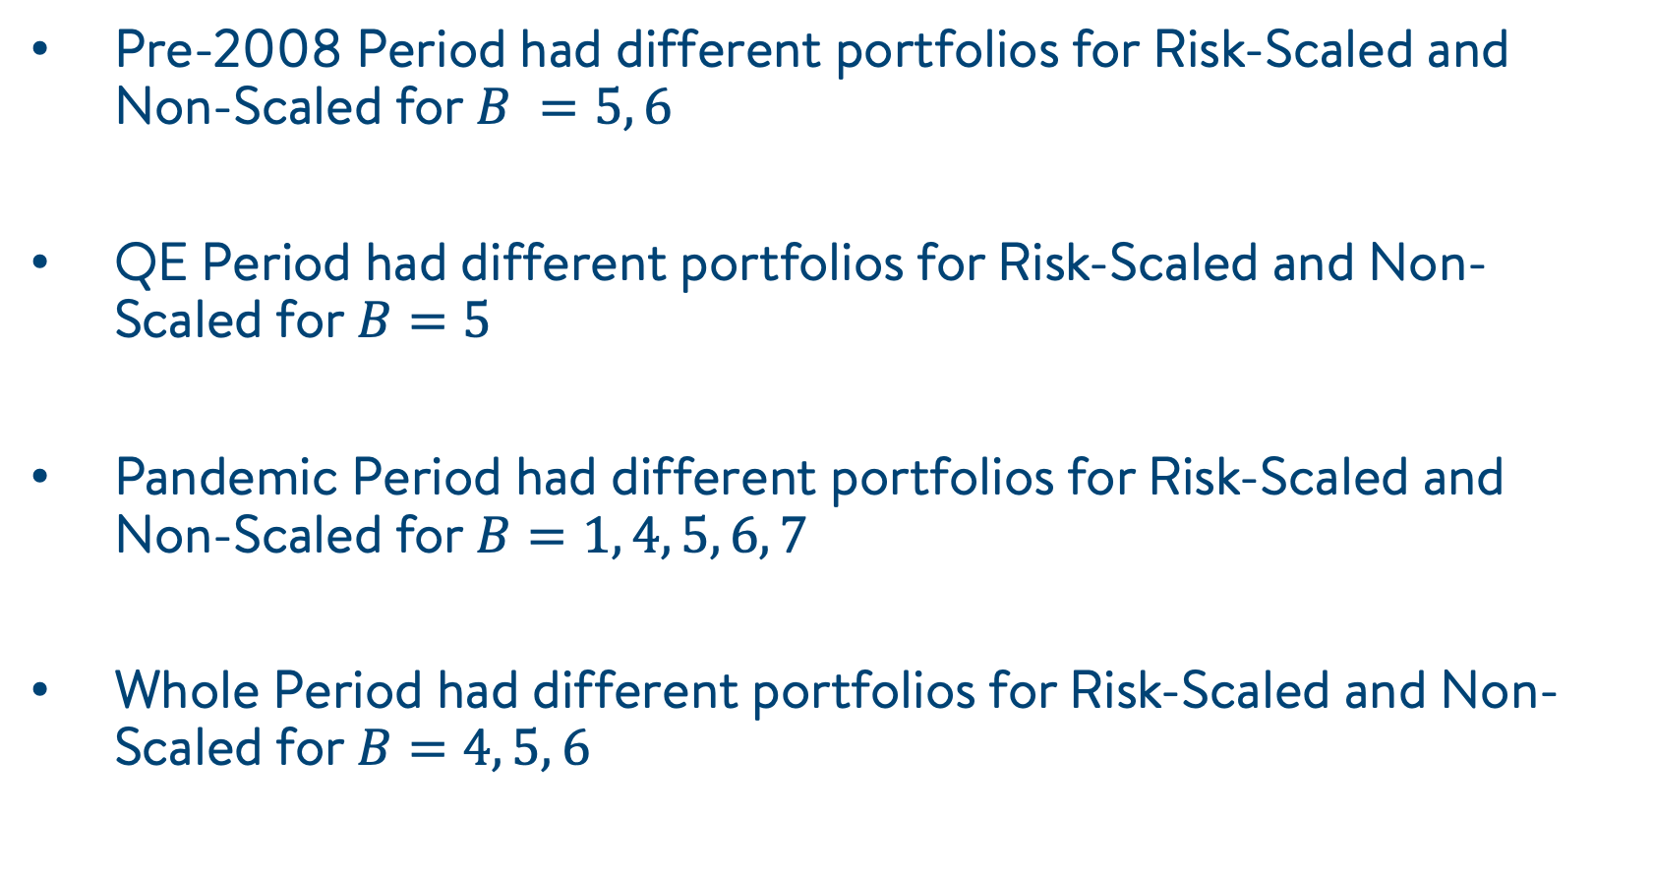
Results
Pre-2008 Period had different portfolios for Risk-Scaled and Non-Scaled for $B =5, 6$
QE Period had different portfolios for Risk-Scaled and Non-Scaled for $B=5$
Pandemic Period had different portfolios for Risk-Scaled and Non-Scaled for $B=1, 4, 5, 6, 7$
Whole Period had different portfolios for Risk-Scaled and Non-Scaled for $B=4, 5, 6$

Slide 35
Results
The Risk-Parity weight calculations give a portfolio of:
Global Equity – 22.3%
S&P 500 – 23.3%
US Midcap – 20.4%
Asia Ex-Japan – 17.3%
Emerging Markets – 16.5%

Slide 36
Summary
We mapped a common problem of portfolio optimization to something that could be calculated using a gate model quantum computer.
We applied VQE and QAOA to pick the best subset of assets in an endowment portfolio, over a variety of periods.
We applied this in combination with risk-parity analysis to obtain the weights for the assets within the winning portfolio.

Slide 37
The Academic Collaboration in Finance Program
For more information, please e-mail: anish.verma@1qbit.com

